Slide 1
Credit Less Loan Approval Predictor
Presented By-
Kanika Tiwari (2022UCA2848)
Chitra Agrawal (2022UCA1868)
Presented To: Dr. Gaurav Singal

Slide 2
Table of Content
Introduction
Motivation
Problem Statement
Contributions, Novelty
Literature Work, Summary, Research Gap
Methodology, Algorithms, Approach
Hardware, Software, Prototype
Results/Graphs, Observations
Issues
Conclusion and Future Work
Code/Github Link/Repository
Total Cost Distribution
Thank you

Slide 3

Introduction
A checks a person's ability to repay a loan using non-traditional Credit-less Loan Approval Predictor al information like income stability and payments for rent or utilities, rather than just credit scores and job history..
Our project uses machine learning to help people without traditional credit histories, like freelancers, self-employed individuals, and newcomers, to get loans fairly.

Slide 4
Motivation
Traditional loan approval processes often exclude individuals like freelancers, self-employed workers, and newcomers who lack a traditional credit history. This creates financial barriers for responsible borrowers. This project aims to bridge that gap by using alternative data and technology to offer fair loan access to a wider range of people, regardless of their employment type or credit score.

Slide 5
Problem Statement
Traditional loan approval systems rely on credit scores and job records, which often exclude freelancers, self-employed individuals, and newcomers who lack these conventional records. Despite being financially responsible, these groups are frequently denied loans, limiting their financial growth. This highlights the need for alternative methods to assess financial reliability, considering diverse financial profiles beyond traditional credit data.

Slide 6
Contribution and Novelty
Contribution
Novelty
Individuals with non-traditional financial situations, like freelancers and self-employed people, access loans. By considering more than just credit scores and job records, it makes loan approval easier for diverse work styles, bridging the gap between modern financial profiles and traditional banking systems.
This project uses alternative financial data and smart technology to assess loan candidates, going beyond traditional credit scores and job records. It offers a fairer loan process by giving people who don’t fit conventional criteria a chance to get loans.

Slide 7
Literature Work, Summary, Research Gap
Various machine learning techniques, including Decision Tree, Random Forest, and Logistic Regression, improve loan prediction accuracy. GBM helps in credit recovery, and social media data can assess credit scores. These methods aim to reduce risks and simplify loan approvals.
Machine learning algorithms like Logistic Regression, Random Forest, and GBM improve loan approval predictions. Using data such as spending habits, utility payments, and transaction patterns helps include people without traditional credit histories. These methods promote financial inclusion and ensure transparency with explainable models.
Traditional loan approval methods rely on credit scores and stable jobs, excluding non-traditional earners. There is limited research integrating alternative financial data like spending patterns and rent payments. Challenges remain in addressing biases and ensuring fairness in decision-making. Current machine learning models also struggle with imbalanced datasets and achieving high recall and AUC-ROC scores.

Slide 8
Methodology, Algorithms, Approach
The researchers designed a system to predict loan approvals without relying on traditional credit scores. A synthetic dataset with 10 financial attributes, like payment history and income stability, was created to train machine learning models. The system was validated using metrics like accuracy, precision, and recall.
Four algorithms were used: Random Forest, Logistic Regression, K-Nearest Neighbors (KNN), and Naive Bayes. Random Forest was the most accurate, offering high precision and reliability. Other algorithms like Logistic Regression and Naive Bayes provided interpretability and efficiency, while KNN captured complex data patterns but required careful tuning.
The project followed a structured approach, starting with data preparation and feature selection. Machine learning models were trained and tested, with Random Forest emerging as the best performer. Finally, a user-friendly prototype application was developed to implement the solution practically.

Slide 9
Hardware, Software, Prototype
State-of-the-art hardware, including CPU, GPU, RAM, and storage, is essential for efficient data processing, model training, and validation in machine learning tasks. These components handle large data volumes and ensure smooth algorithm performance.
Key software includes Python programming language and libraries such as scikit-learn, Pandas, and NumPy for data analysis and machine learning. Additional tools like Jupyter Notebook were used for development and testing.
A user-friendly loan eligibility prediction system was developed, utilizing machine learning models like Random Forest. The prototype assesses applicant data (e.g., payment history, income stability) to provide reliable loan approval predictions.

Slide 10
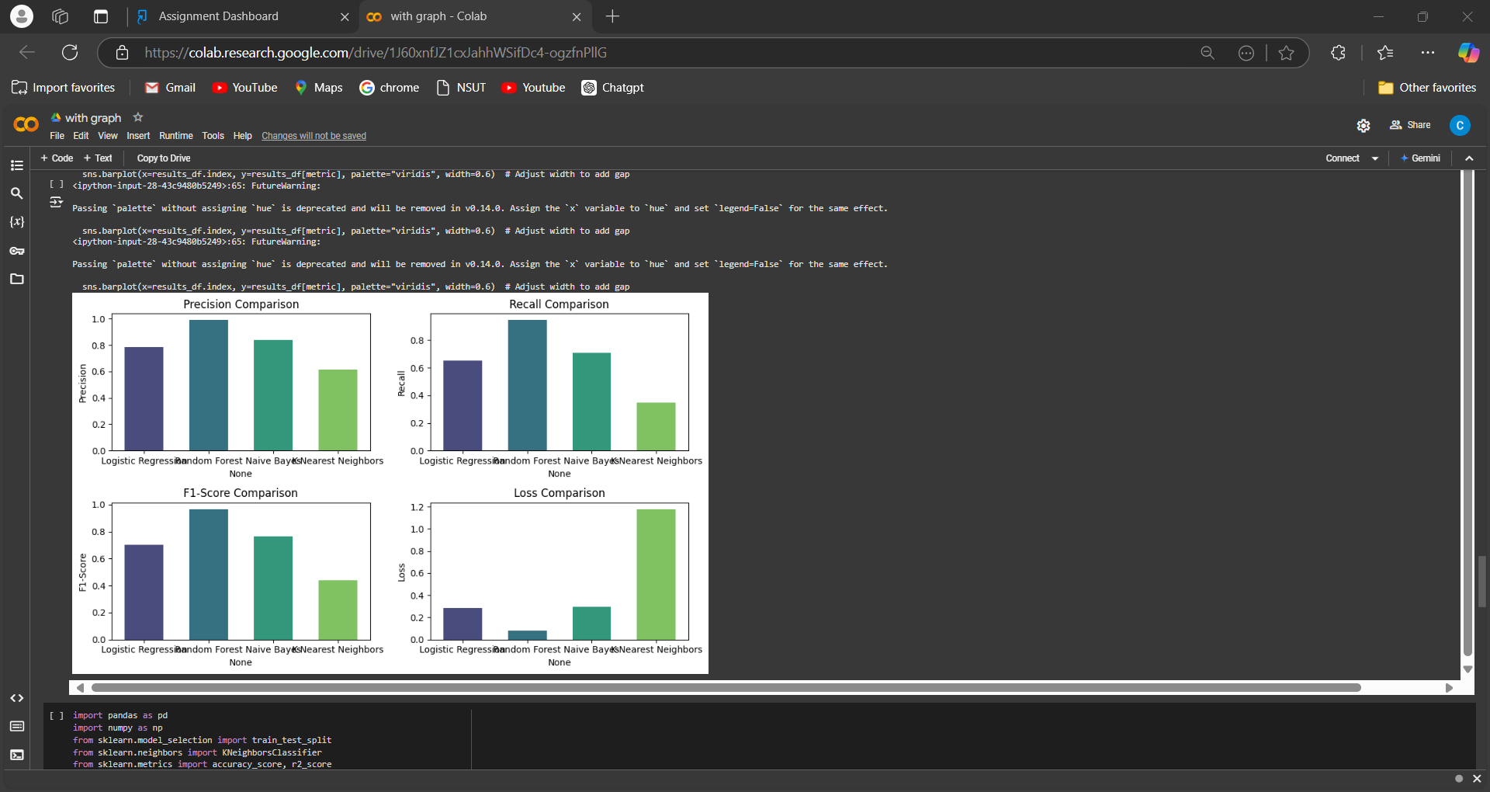
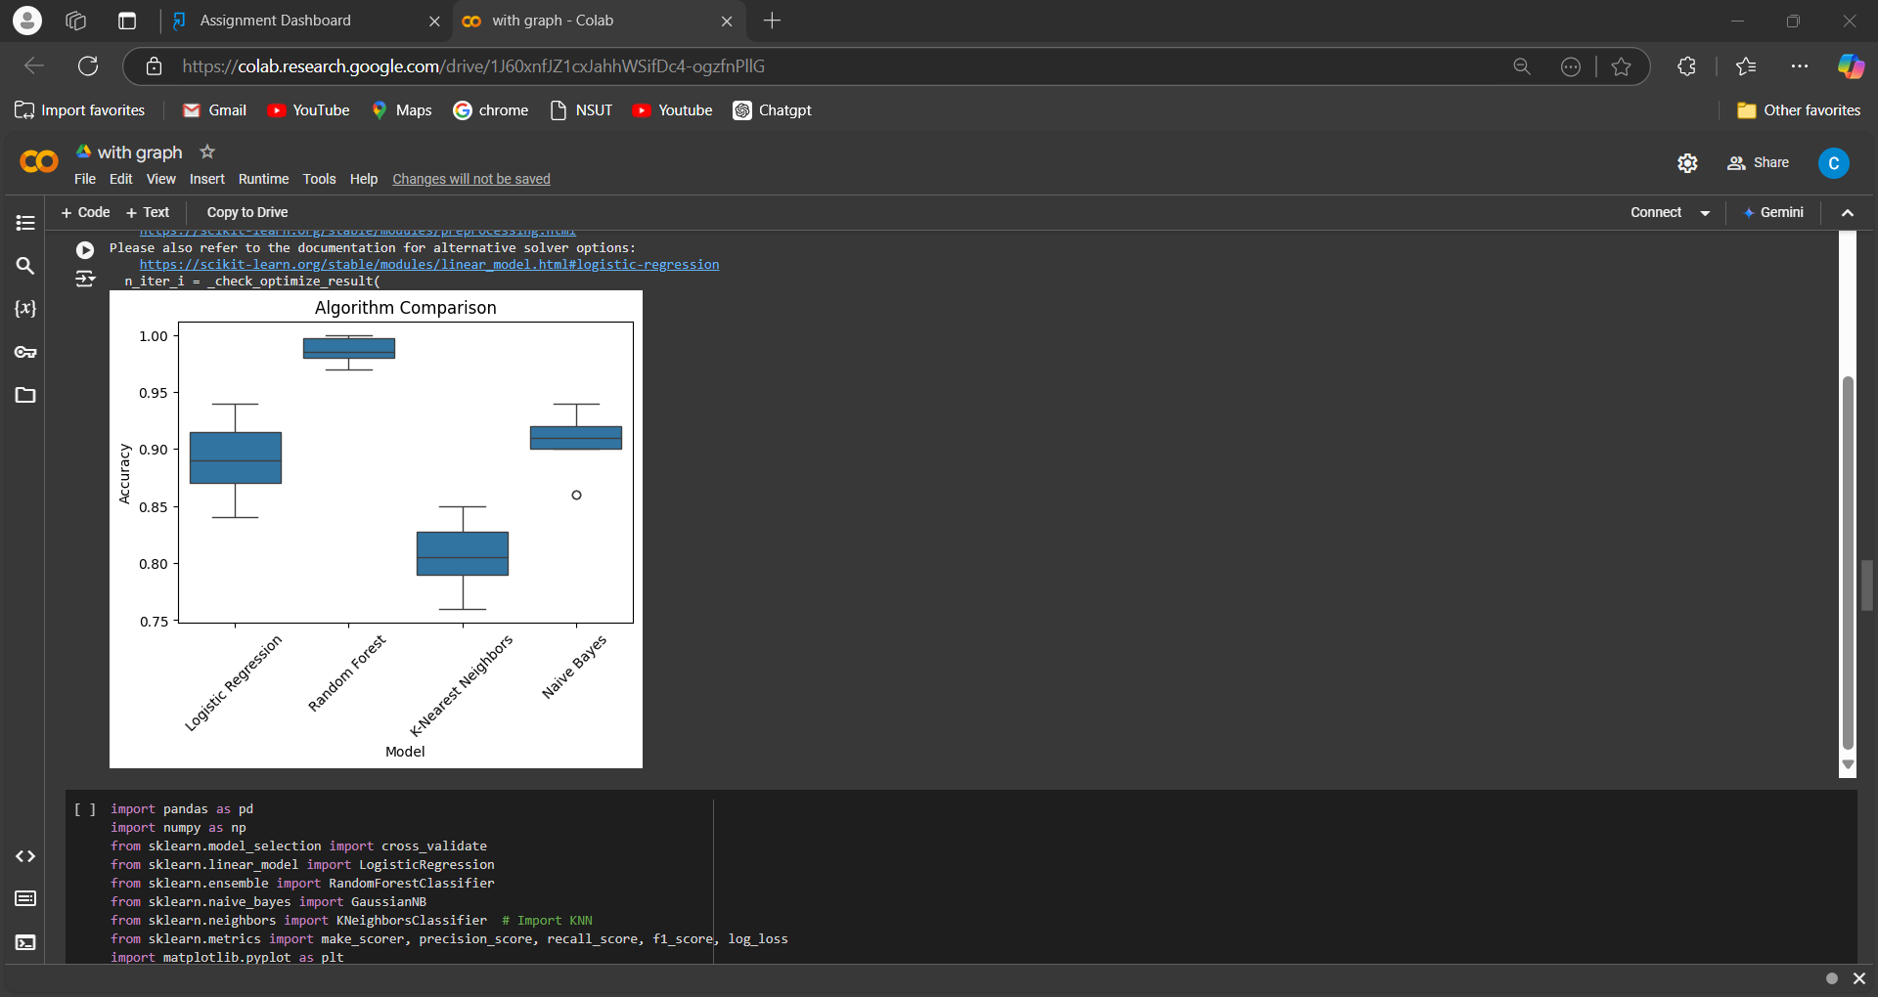
Result/Graphs
Random Forest achieves high accuracy (0.912) with a good balance between precision (0.91) and recall(0.632653).

Slide 11
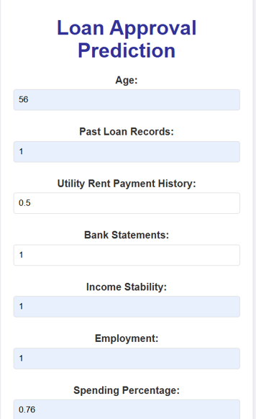
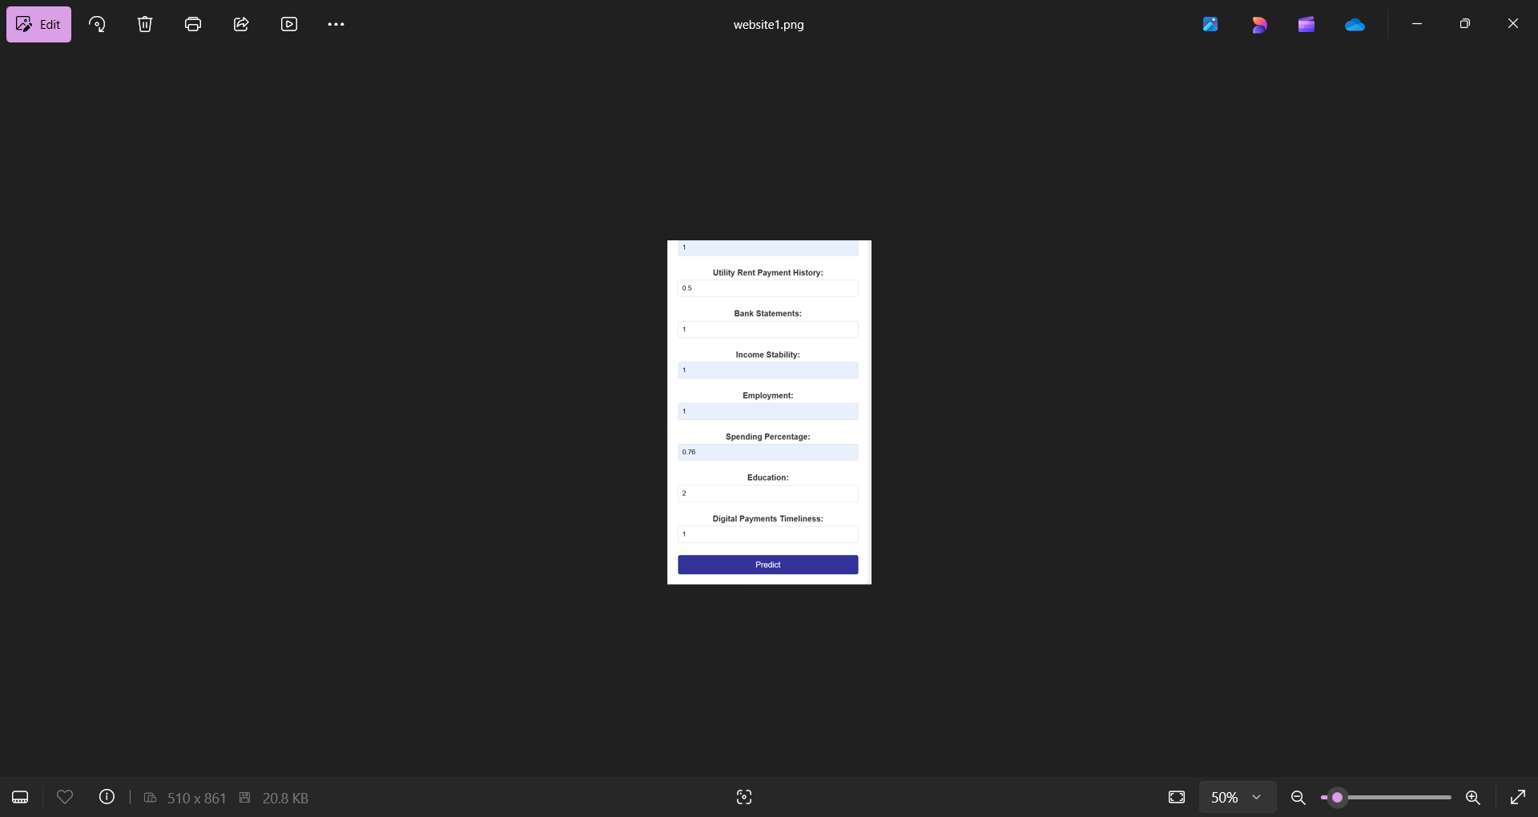
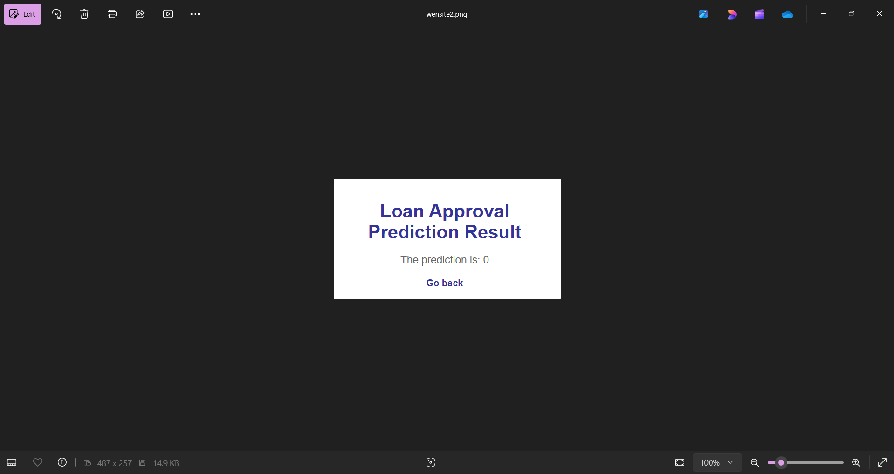

Slide 12
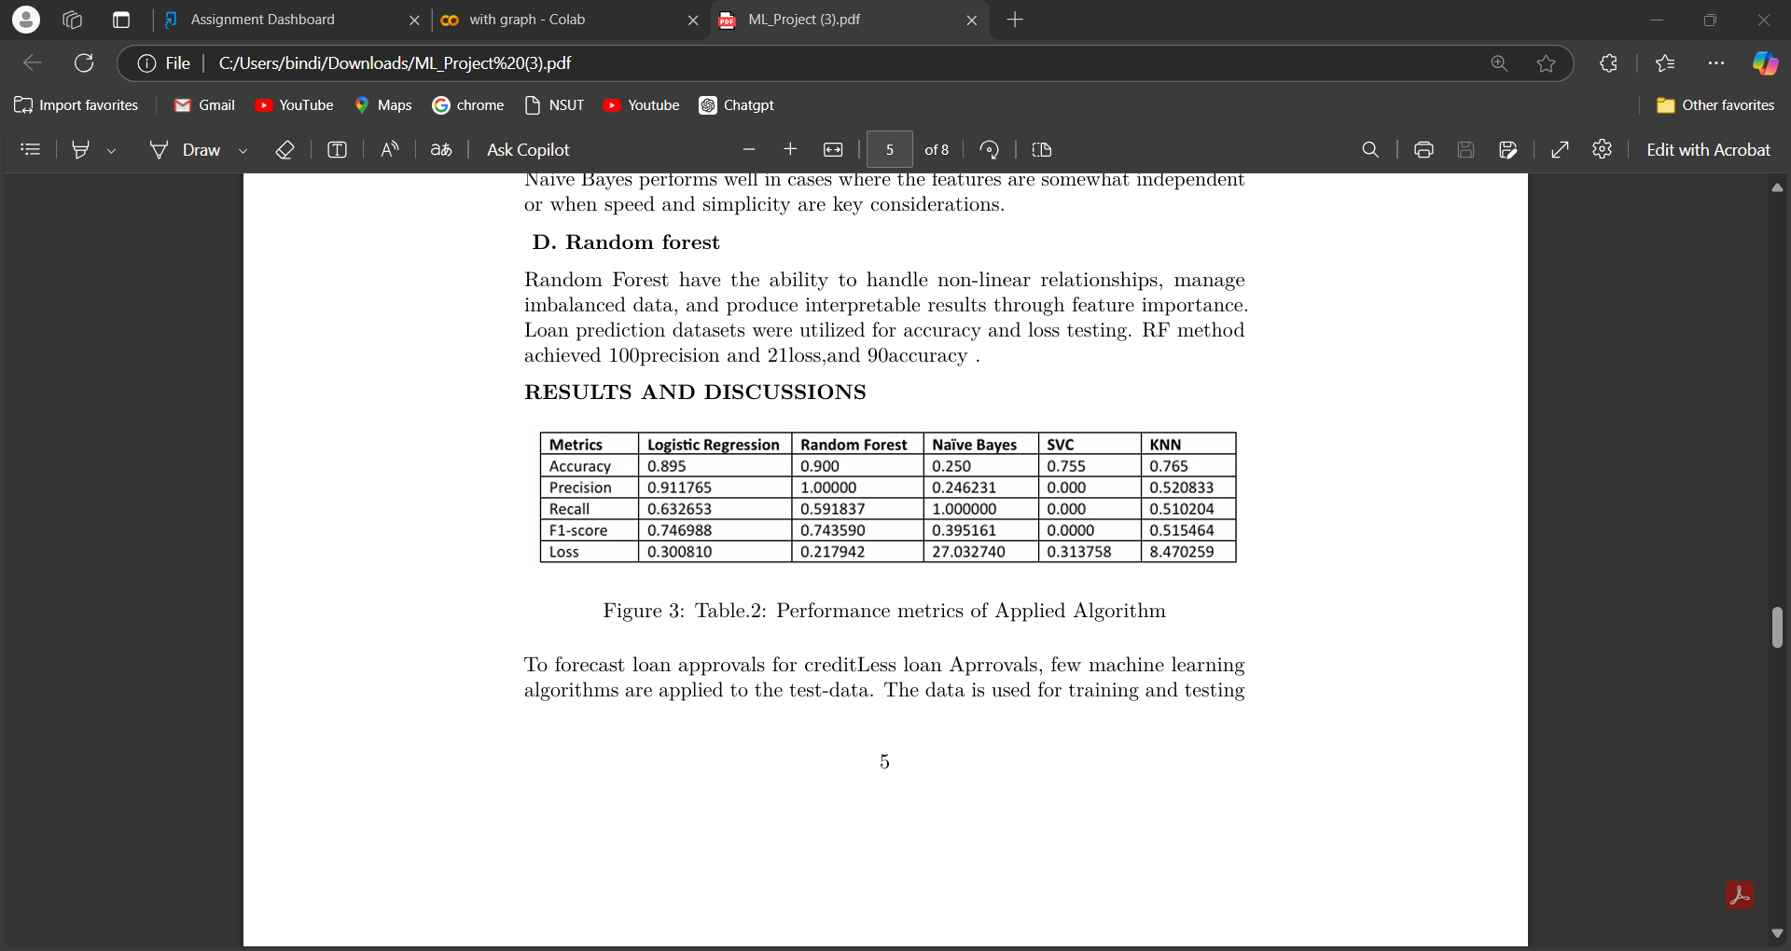
Observations
Random Forest shows the most potential with high accuracy and perfect precision, but needs optimization for better recall and AUC-ROC. Logistic Regression balances accuracy but struggles with class separation. Naive Bayes has perfect recall but poor accuracy due to false positives, while K-Nearest Neighbors struggles with low precision, recall, and AUC-ROC.

Slide 13
Issues
Data Limitations: The dataset was synthetically generated, which may not fully capture real-world complexities.
Model Bias: Machine learning models may inherit biases from the input data, impacting fairness.
Scalability: High-performing models like Random Forest can be computationally intensive, limiting scalability for large datasets.
Feature Selection: Ensuring the inclusion of the most relevant financial metrics remains challenging.

Slide 14
Conclusion and Future Work
Random Forest is the most effective model for credit loan approval prediction, with an optimal accuracy of nearly 89%, though improvements are needed for recall and AUC-ROC. Logistic Regression shows a good balance between precision and recall. Naive Bayes and KNN perform poorly due to low precision and recall. Further tuning is needed to improve performance, especially in handling class imbalances and optimizing recall and AUC scores.

Slide 15
Code/Github Link/Repository
https://github.com/KanikaTiwarii/LOAN-APPROVAL-PREDICTOR/blob/main/README.md

Slide 16
Total Cost Distribution
The total cost of the project primarily involves the following components:
Software: Costs associated with acquiring licenses for tools or libraries (if applicable), though most used libraries are open-source (e.g., Python, scikit-learn).
Hardware: Investment in computers or servers with sufficient processing power for model training and testing.
Development: Labor costs for data preparation, model development, and the creation of the user interface
Miscellaneous: Any additional costs related to data acquisition (if not synthetic), cloud storage, or project management.

Slide 17
Thank you

